Slide 1
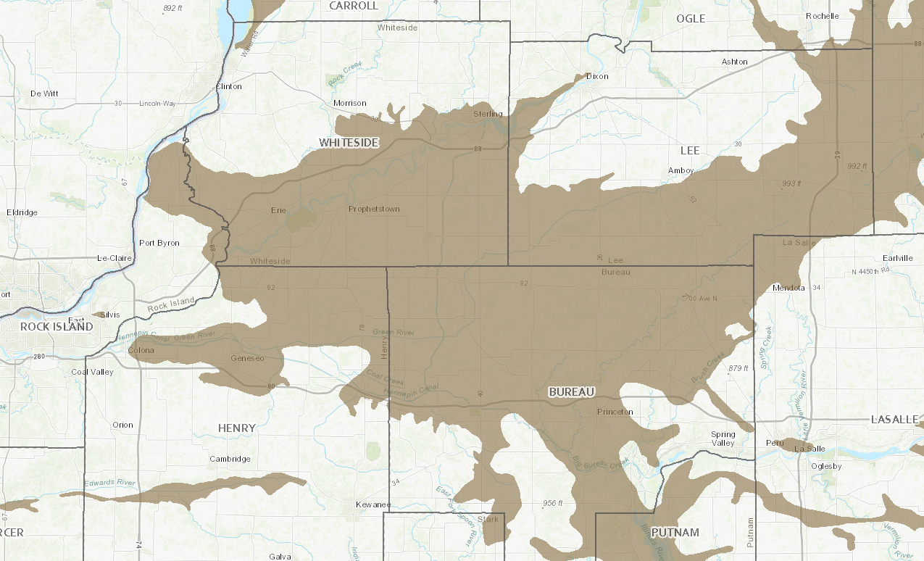
1
1
2
3
1
4
5
6

Slide 2
W
E
Topsoil
Clay
Combined
Sand Aqu.

Slide 3
N
S
Rock River
Topsoil
Topsoil
Sand (T)
Clay
Sand
Sand (S)

Slide 4
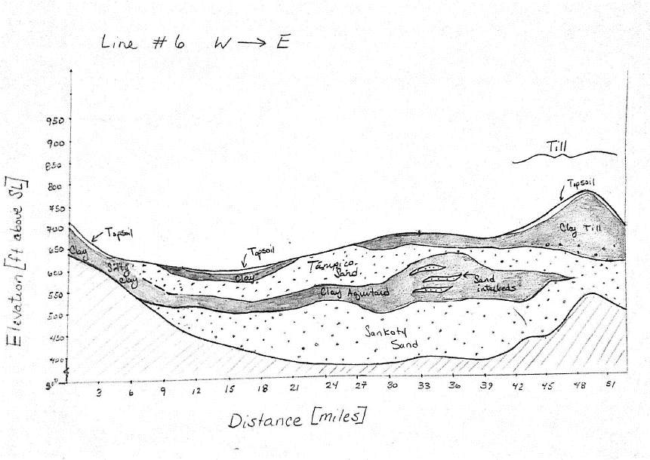

Slide 5
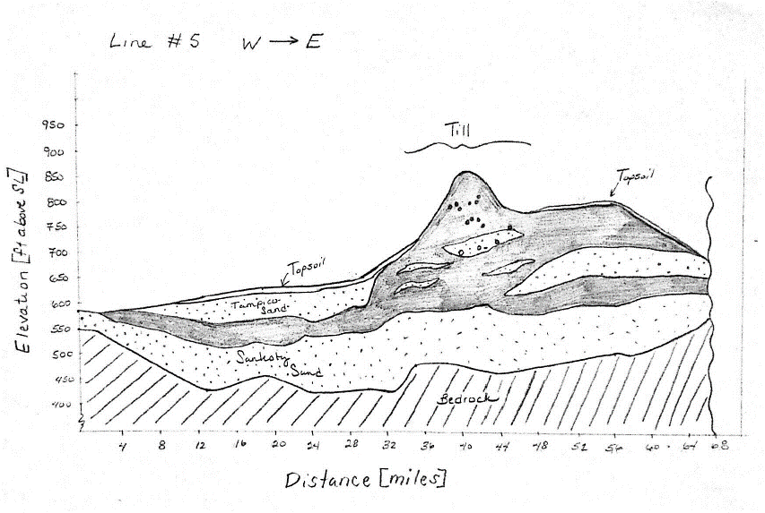

Slide 6
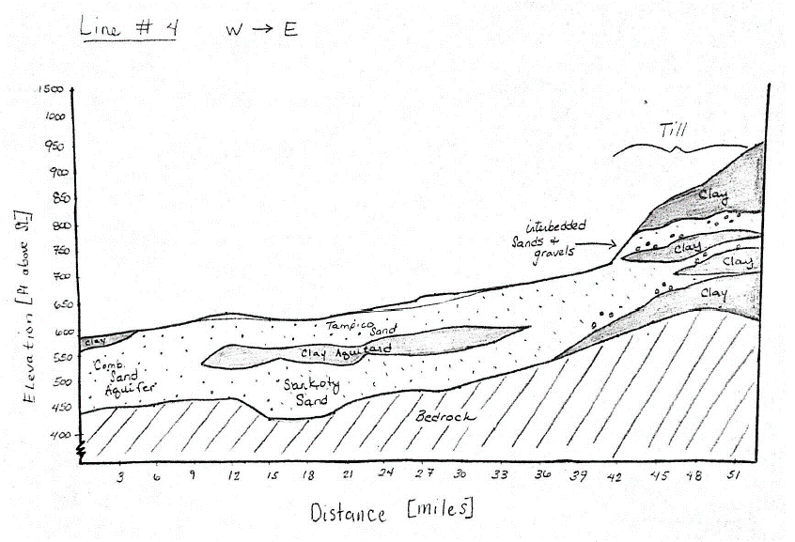

Slide 7
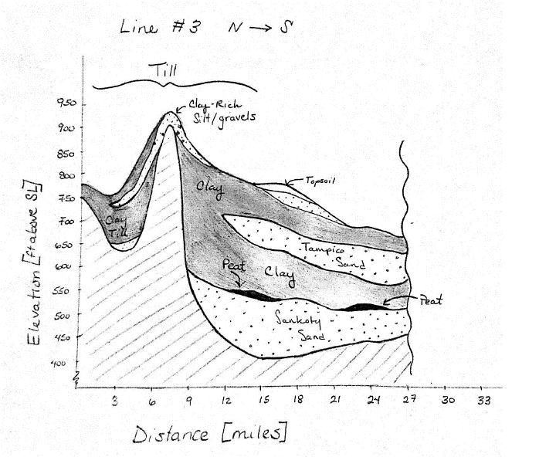

Slide 8
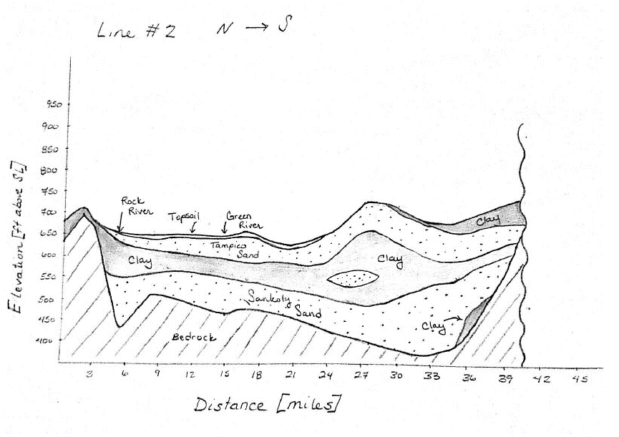

Slide 9
